Slide 1
Asynchronous vs Parallel Programming
Brandon Minnick
Code Traveler, LLC
Notes:
Welcome to Day 2. Yesterday was asynchronous programming: what the compiler does to your async methods, how a Task tracks completion, and how to stop holding a thread while you wait. Today we use many threads on purpose.
Those two words get used as if they mean the same thing, and they do not. Asynchronous is about waiting efficiently. Parallel is about working simultaneously. You can have either one without the other, and most real systems have both at once.
This matters for a very practical reason. The moment two threads run your code at the same time, every field they share becomes a shared resource, and code you have read a hundred times becomes wrong. This morning we look at three bugs in a checkout app. All three pass a single-user test. All three fall apart the first time real traffic arrives.
Then you fix them with four primitives: Interlocked, Lock, Lazy of T, and SemaphoreSlim. Every one of them is in the box already. The skill is knowing which one fits which piece of state.
https://learn.microsoft.com/dotnet/standard/parallel-programming/

Slide 2
Waiting Is Not Working
Asynchronous frees a thread. Parallel adds threads.
Notes:
Here is the one sentence version of the whole lecture. Asynchronous programming is about not holding a thread while you wait. Parallel programming is about putting more threads to work at the same time. They solve different problems, and you pick based on what is actually slow.
If your code is waiting on a network call, a database, or a disk, that is I/O, and nothing is running. Asynchronous is the answer, because the thread you were holding can go serve somebody else. Adding threads there just gives you more threads standing around doing nothing.
If your code is genuinely computing something, scoring a million rows or resizing images, a thread really is busy. Awaiting does not help, because there is nothing to wait for. Parallel is the answer, because eight cores can do roughly eight times the work.
And the two combine constantly. A parallel loop whose body awaits an HTTP call is both at once. That is exactly the shape of the app you are about to fix.
https://learn.microsoft.com/dotnet/standard/parallel-programming/

Slide 3
Asynchronous Programming System.Threading.Tasks
Allows code to execute on a background thread
By default, and only once it actually yields
`await` pauses execution until the `Task` has completed
Releases the calling thread while `await`ing
Optimizes for I/O: network, disk, database
Notes:
Start from what you already know. A Task is a promise that tracks completion. When you await it, the compiler splits your method at that point, hands the rest of it to the Task as a continuation, and returns. The thread that was running your method goes back to the pool and picks up somebody else's work.
That is the whole trick, and it is worth being blunt about what it does not do. Awaiting an HTTP call does not make the call faster. Nothing is running while you wait. There is no thread sitting in a loop checking whether the response arrived. The network card interrupts, the I/O completion port fires, and your continuation gets scheduled.
So asynchronous programming buys you thread count, not speed. One web server that awaits its database calls can hold ten thousand pending requests on a handful of threads. The same server blocking on those calls needs ten thousand threads, and it will fall over long before it gets there.
https://learn.microsoft.com/dotnet/csharp/asynchronous-programming/

Slide 4
Parallel Programming Many Threads, On Purpose
Multiple Tasks Running Concurrently
Multiple Tasks Running on Background Threads
Limited by hardware resources
`Environment.ProcessorCount`
Notes:
Parallel is the opposite trade. You are not trying to free a thread, you are trying to use more of them, because the work is real and somebody has to do it.
Multiple tasks running concurrently, on background threads, at the same instant. If you have eight cores and eight chunks of independent CPU work, eight threads finish in roughly the time one chunk takes. That is the win, and it is a real one.
It is also bounded, and the ceiling has a name. Environment.ProcessorCount is how many threads can genuinely run at once, and it is the default degree of parallelism for the Parallel class. Spinning up thirty-two threads on an eight-core machine does not make it four times faster; it makes the operating system spend its time switching between them. Remember that number, because it turns up again as an answer in the app you are about to fix.
And there is a cost you pay immediately, before you get any of the win. The moment two of those threads touch the same object, you have a correctness problem that did not exist a minute ago. That is the rest of this lecture.
https://learn.microsoft.com/dotnet/standard/parallel-programming/data-parallelism-task-parallel-library

Slide 5
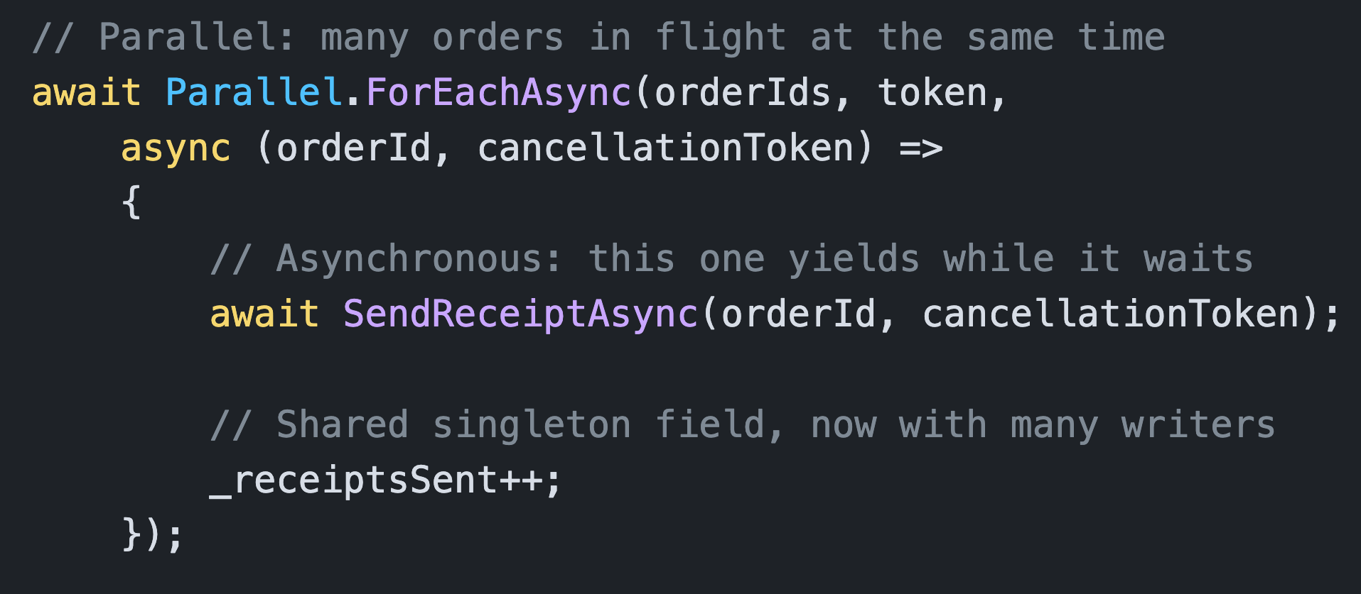
Parallel.ForEachAsync() Execute Multiple Functions Simultaneously
Parallel gives you many threads
Asynchronous
Prevents each thread from blocking
Warning
`_receiptsSent++` now has many simultaneous writers
Notes:
This is the shape almost every real system ends up with, and it is worth reading slowly because both ideas are on screen at once.
Parallel.ForEachAsync is the parallel half. It runs the body for many items at the same time, on many threads, and it takes an async body, which the older Parallel.ForEach does not. How many at the same time? By default, Environment.ProcessorCount, unless you pass ParallelOptions and say otherwise. We come back to that this afternoon.
The await inside the body is the asynchronous half. Each iteration yields its thread while the receipt call is in flight, so the pool can keep starting more iterations instead of running out of threads.
Now look at the last line. That plain increment was completely fine yesterday, when one request at a time reached it. Today one thread per core reaches it in the same microsecond, and it is a bug. Nothing about the line changed. What changed is how many threads are standing on it. Parallelism does not introduce new syntax, it invalidates assumptions you did not know you were making.
https://learn.microsoft.com/dotnet/api/system.threading.tasks.parallel.foreachasync

Slide 6
Deadlocks + Race Conditions
Notes:
Two failure modes, and they are opposites, which is a useful way to hold them in your head.
A race condition is what happens when threads do not coordinate enough. They all charge through the same state, they interleave in an order nobody planned, and the result is silently wrong. Nothing hangs, nothing throws, the number is just incorrect. These are the expensive bugs, because you can ship them and not find out for months.
A deadlock is what happens when threads coordinate too much, or coordinate badly. Everybody is politely waiting for somebody else, and nobody moves. Deadlocks are more painful in the moment and much easier to diagnose, because the symptom is obvious: it stopped.
The OrderPortal app has both. Two race conditions in the metrics and the tax provider, and one deadlock in the inventory ledger. Over the next few slides we walk through what causes each one, and the four tools .NET gives you to prevent them.
https://learn.microsoft.com/dotnet/standard/threading/managed-threading-best-practices

Slide 7
Race Conditions Two Threads, One Field
Two (or more) Threads touching the same state
Increment / Decrement Pitfalls
Three operations: Read, add/subtract, write
Eg `count++`, `count--`
Null Coalescing Operator Pitfalls
Two operations: check-then-assign
E.g. `_field ??= Build()`
Both threads see `null`, both execute `Build()`
Notes:
Two or more threads touching the same state, in an order nobody controls. Note that it is the state, not the code: a thread reading the order count to render the page races with a thread writing it from a checkout, and those two are running completely different methods.
The damage comes from operations that look atomic in C# but are not atomic in machine code. Take the increment. In your source it is one character. At runtime it is three steps: read the current value into a register, add one, write it back. Two threads read the same value of one, both compute two, and both write two. Two orders were placed and the counter moved by one. Nothing threw. The order is in the database. Only the metric is wrong, which is the worst possible place for it to be wrong, because nobody notices for a quarter.
The null-coalescing assignment has the identical shape. Check whether the field is null, then assign. One thread per core got into that gap in the OrderPortal run, so the expensive table was built once per core, and every result but one was thrown away after everybody paid for it.
https://learn.microsoft.com/dotnet/standard/threading/managed-threading-best-practices

Slide 8
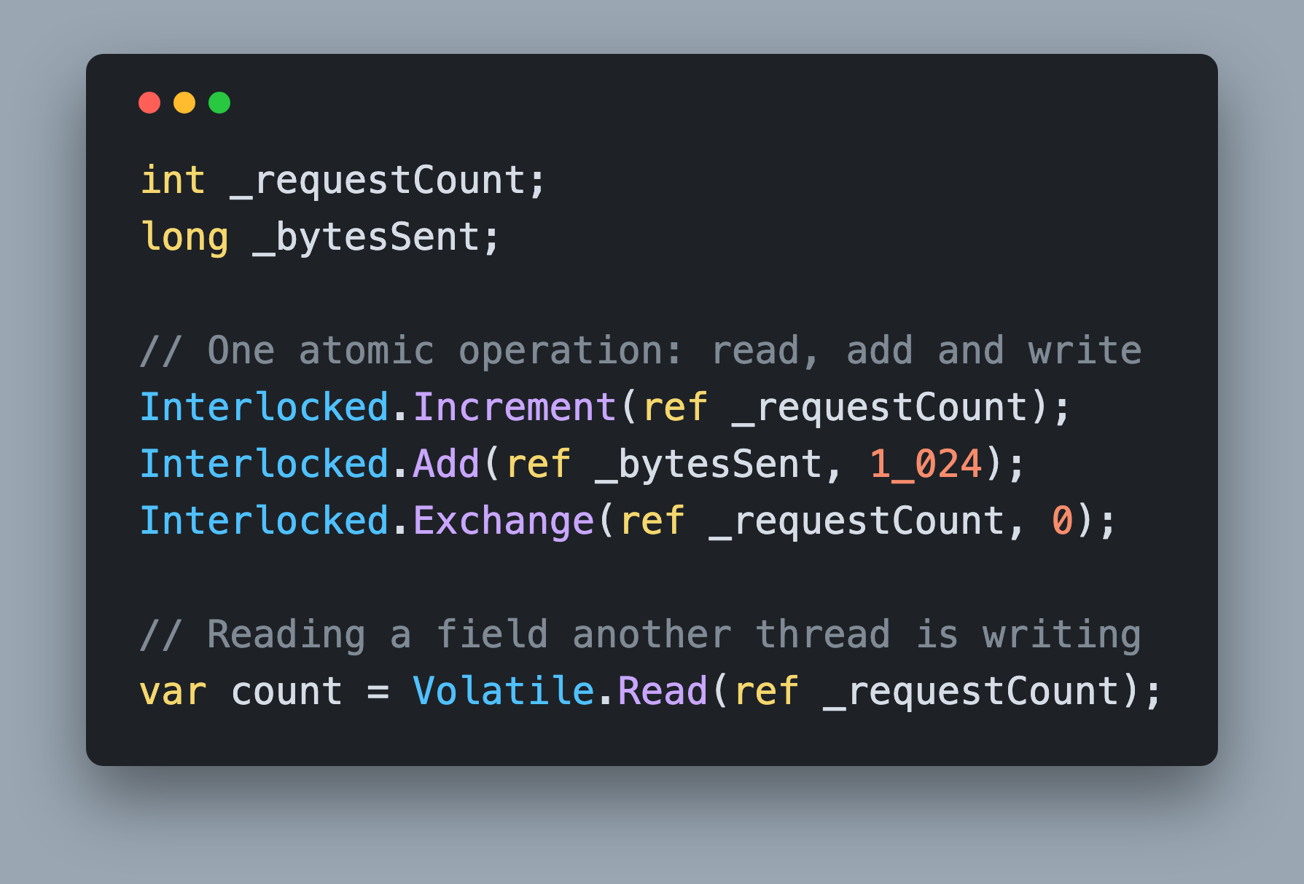
Interlocked System.Threading.Interlocked
High-performance locking
`Increment`, `Decrement`, `Add`: `int` and `long`
No `decimal` overload
Notes:
Interlocked is the cheapest tool in the box, and for a counter it is the right one. It compiles down to a single processor instruction that performs the read, the add and the write as one indivisible step. No other thread can get in the middle, and no thread ever blocks, so it is fully lock-free: there is no lock to contend for and no chance of a deadlock.
Increment, Decrement and Add cover int and long, which is why the byte counter on this slide is declared as a long. Exchange sets a new value and hands you the old one. CompareExchange, which you will meet again in the Concurrent Collections section, sets a new value only if the field still holds the value you expected, and it is the foundation almost every lock-free algorithm is built on.
The important limitation for this challenge is that there is no decimal overload. Decimal is 128 bits and cannot be written atomically, so money needs a real lock.
And do not forget the reader. Volatile.Read stops the compiler and the CPU from handing you a stale cached value.
https://learn.microsoft.com/dotnet/api/system.threading.interlocked

Slide 9
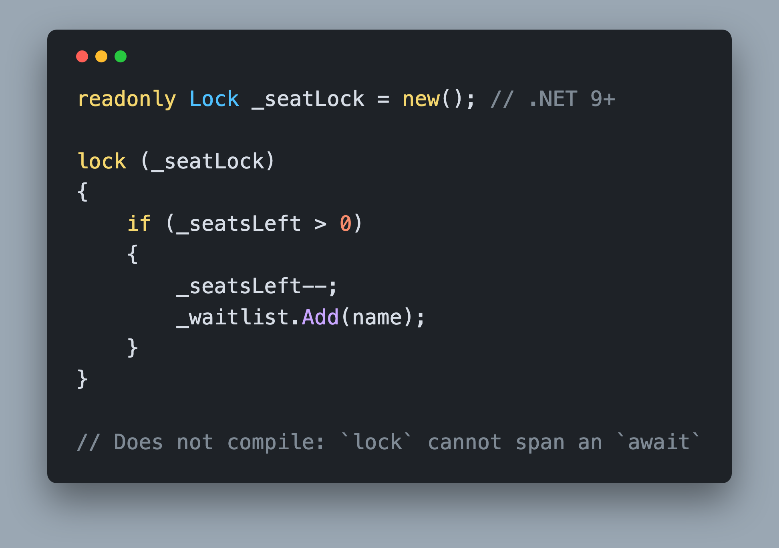
Lock System.Threading.Lock
For synchronous locking
Use `Lock`
`Lock` cannot be held across an `await`
Notes:
When Interlocked cannot express the update, you take a lock. One thread at a time gets inside the block, and everybody else waits at the door.
Look at why Interlocked cannot help here. Two fields have to change together, and only if a third condition still holds. There is no single instruction for that, and no way to split it into two atomic steps without another thread seeing the state halfway through. That is what a lock is for.
.NET 9 added System.Threading.Lock, a real type for this job instead of locking on an arbitrary object. Declare it once as a readonly field and use it with the ordinary lock statement, which the compiler now understands. It is faster than the old monitor path and, more usefully, it is self-documenting: a Lock field can only be a lock, so nobody accidentally locks on something they also expose publicly. Before .NET 9 a readonly object field does the same job.
The rule to memorize is the last line. You cannot await inside a lock block. It is a compiler error, because a monitor is owned by a thread, and after an await your continuation may resume on a different one.
https://learn.microsoft.com/dotnet/csharp/language-reference/statements/lock

Slide 10
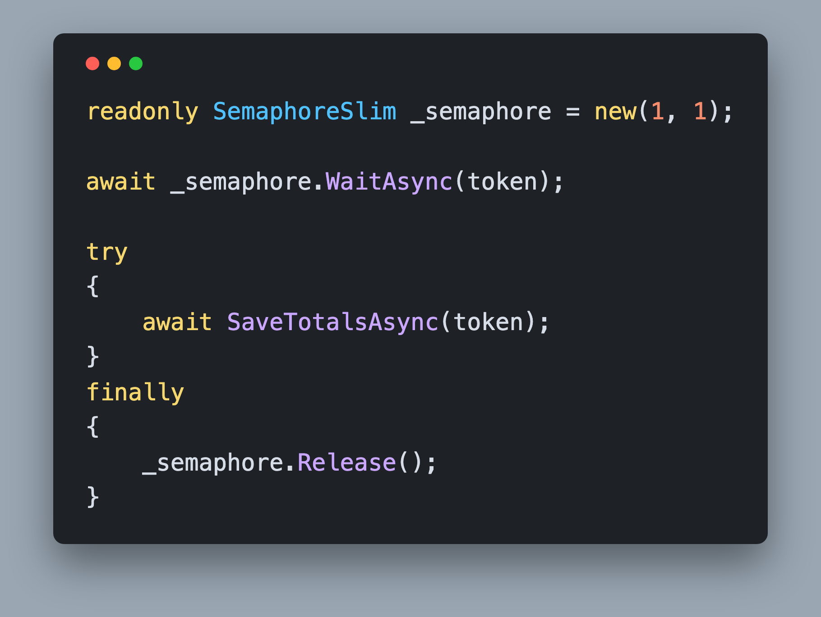
SemaphoreSlim The Asynchronous Lock
For asynchronous locking
`new(1, 1)`
Sets the initial thread count to 1
Sets the maximum thread count to 1
Always `Release()` in a `finally` block
Notes:
So if lock cannot span an await, what guards a critical section that has to do I/O? SemaphoreSlim. It is the asynchronous lock, and it is the answer to that question in essentially every codebase.
A semaphore holds a number of permits. Construct it with one initial and one maximum permit and it behaves as a mutual exclusion lock: one holder at a time. WaitAsync takes a permit, and it is awaitable, so the waiting thread is released rather than blocked. Pass your CancellationToken, so a caller that gives up stops waiting.
The shape matters. Take the permit, then open a try, and release in the finally. If the body throws and you release outside a finally, that permit is gone for the lifetime of the process and every future caller waits forever. Take it, try, finally release. Make it muscle memory.
One more property, and it is the one that bites people, so it gets its own slide.
https://learn.microsoft.com/dotnet/api/system.threading.semaphoreslim

Slide 11
Deadlocks Two (or more) Threads waiting for the other to finish
Avoid Circular References
One Thread deadlocking against itself
Waiting for itself to finish the work it is waiting on
Notes:
The textbook deadlock is two threads and two locks. Thread one holds the pantry and wants the fridge. Thread two holds the fridge and wants the pantry. Neither will let go, so neither moves. The general rule that prevents it is to avoid circular references: if every thread takes locks in the same order, that cycle cannot form.
The version you will actually meet is smaller and sneakier. One caller, one lock, no cycle you can draw. A method takes a non-reentrant lock and calls a helper that takes the same lock. That is the whole bug, and with an awaited WaitAsync there is not even a blocked thread to find in a dump.
The fix is a pattern worth memorizing, and it is what the finished sample does. Split the operation in two. A public method that takes the lock and then calls the private one, and a private method, conventionally suffixed Core, that does the work and assumes the lock is already held. Callers who hold the lock call the private one. Callers who do not call the public one. Each lock gets taken exactly once, and you leave a comment saying so.
https://learn.microsoft.com/dotnet/standard/threading/managed-threading-best-practices

Slide 12
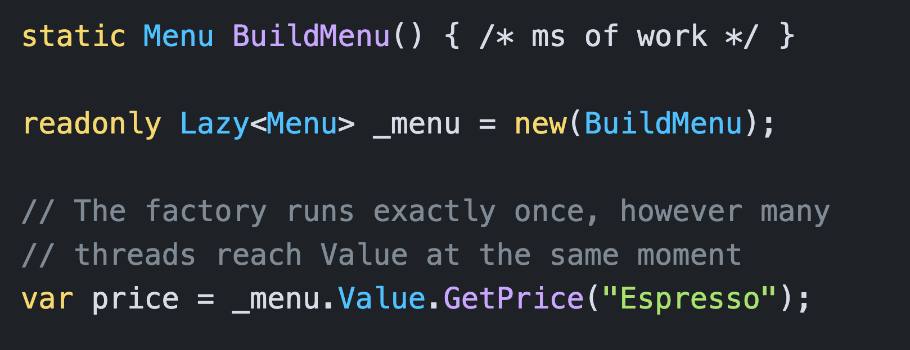
Lazy<T> For Initializing Singletons
Thread safe by default
Replaces `_menu ??= BuildMenu()`
Every caller gets the same instance
Notes:
Lazy of T is the fix for the expensive thing that must be created exactly once, and it is the tool most people forget they have.
You give it a factory. Nothing runs until somebody reads Value. The first thread to reach Value runs the factory while every other thread waits, and when it finishes they all get that same instance. Every read after that is a plain field access.
The guarantee comes from the default thread safety mode, LazyThreadSafetyMode.ExecutionAndPublication, which is what you get from the constructors you will normally use. Execution means the factory runs once. Publication means everybody sees the same result. There are other modes, including PublicationOnly, which allows several threads to race and publishes the first winner. That is not what you want when the factory costs 120 milliseconds.
Compare that to the null-coalescing assignment it replaces. Same intent, same amount of code, and only one of them is still correct when one thread per core arrives together.
https://learn.microsoft.com/dotnet/api/system.threading.lazythreadsafetymode

Slide 13
The Toolbox Pick By What You Are Guarding
`Interlocked`: high-performance locking
`Lock`: for synchronous locking
`SemaphoreSlim`: for asynchronous locking
`Lazy<T>`: for initializing Singletons
Concurrent collections: for shared collections
We’ll cover Concurrent Collections in Section 8
Notes:
Keep this slide open during the challenge. Every fix you are about to make is one line on it.
Start at the top and work down, because the list is ordered by cost. Interlocked is free and never blocks, so use it whenever the state is a single int or long. If Interlocked cannot express the update, or the value is a decimal, take a Lock. If the critical section has to await something, you cannot use lock at all, so it is SemaphoreSlim. If the thing you are protecting is one-time initialization rather than an ongoing update, none of those are the right answer and Lazy of T is.
And if the shared state is a collection, do not wrap a Dictionary or a List in a lock and hope. The System.Collections.Concurrent types exist for exactly that, and we spend a whole section on them this afternoon.
The skill here is not memorizing four APIs. It is looking at a field and asking what kind of state it is.
https://learn.microsoft.com/dotnet/standard/threading/overview-of-synchronization-primitives

Slide 14
Challenge Fix the Race Conditions and Deadlocks
Fix `OrderPortal` in 25 minutes
2000 of 2000 orders recorded, revenue matches
Tax table built exactly 1 time
Reserve stock answers instead of timing out
Correct on five runs in a row, not just one
Notes:
Open 5. Asynchronous vs Parallel Programming, 1. Start, OrderPortal.slnx. Build it once, run it on localhost port 5007, and press the button so you see the red cards yourself before you change anything.
You are editing three files: OrderMetrics.cs, TaxRateProvider.cs and InventoryLedger.cs. Every ToDo Refactor comment marks a bug, but they are not the whole list. The unguarded property getters, the two Reset methods and the lookup counter carry no comment at all, and that is deliberate, because in real code nobody labels them either. The README requirements are the complete checklist. Leave CheckoutService, the page, and the singleton registrations alone. The load is not the bug; the load is the test.
You are done when Orders recorded reads 2000, Revenue matches the expected total, Tax table builds reads 1, and Reserve stock answers immediately. Then press the button five more times, because a race condition that passes once has not been fixed, it has been lucky.
Use AI Agents to understand the code and interpret errors, not to solve it. We review as a group before opening SOLUTION.md together.
https://learn.microsoft.com/dotnet/standard/parallel-programming/potential-pitfalls-in-data-and-task-parallelism

